Slide 1
Liquids
Chapter 13

Slide 2
Gases | Liquids | Solids
Variable shape and volume | Variable shape, fixed volume | Fixed shape and volume
May expand or compress | May flow, not compressible | Non-compressible crystalline solids
Low densities | High density | High density
Mix to form homogeneous mixtures | Mix if soluble | Do not mix by diffusion

Slide 3
Intermolecular Forces
Forces holding one molecule to another in a substance.
van der Waals forces
Several types – ion-dipole, dipole-dipole, dipole-induced dipole and London dispersion forces
Hydrogen bonding

Slide 4
Polar Molecules
Dipole - A molecule such as HF which has a positive and a negative end. This dipolar character is often represented by an arrow pointing towards the negative charge.
Dipole moments – the measure of the net molecular polarity
Measured in units of Debyes (D) = Qr (charge x separation)

Slide 6
Polar bonds Non-polar molecules

Slide 7
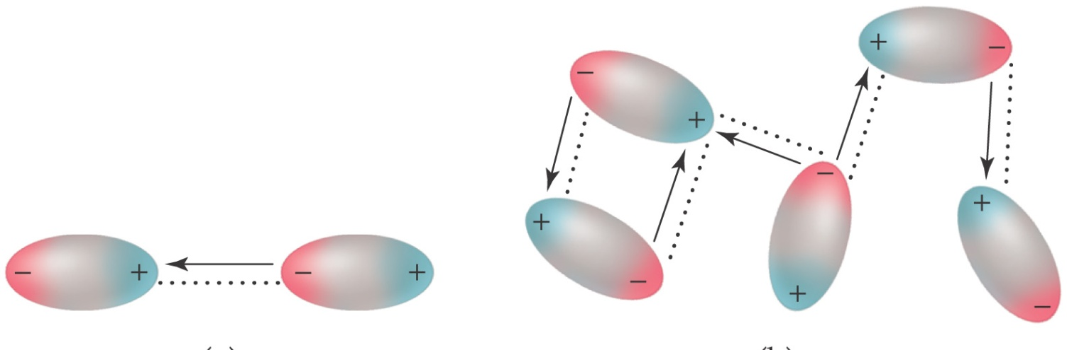
Dipole – Dipole forces
or
Polar - Polar interactions

Slide 8
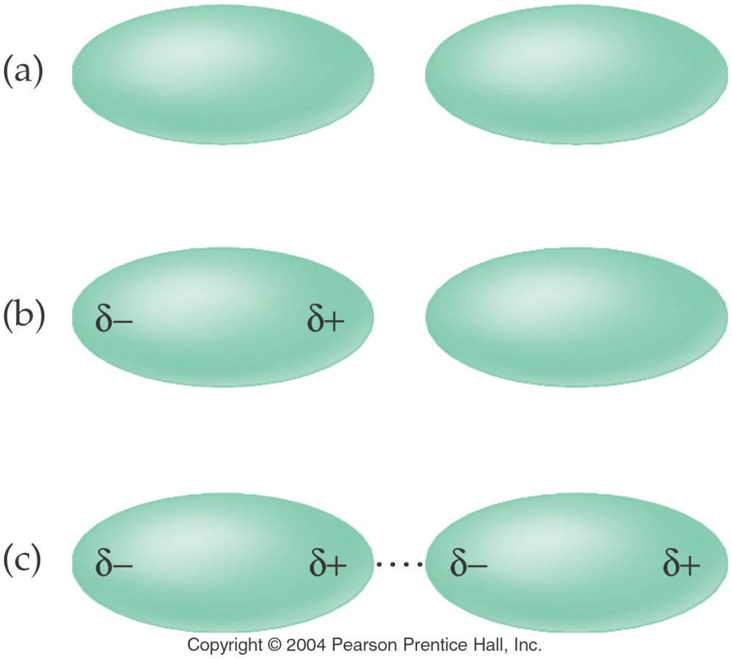
London forces
Induced dipole – induced dipole
or
Nonpolar - Nonpolar interactions

Slide 10
Hydrogen Bonds
A special type of polar interaction between a hydrogen atom bonded to an electronegative element and another electronegative element.

Slide 11
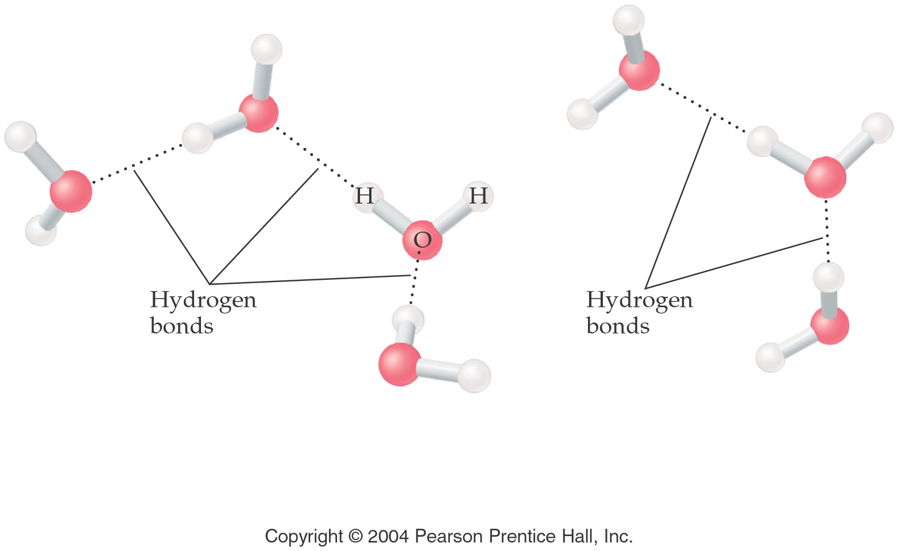

Slide 12
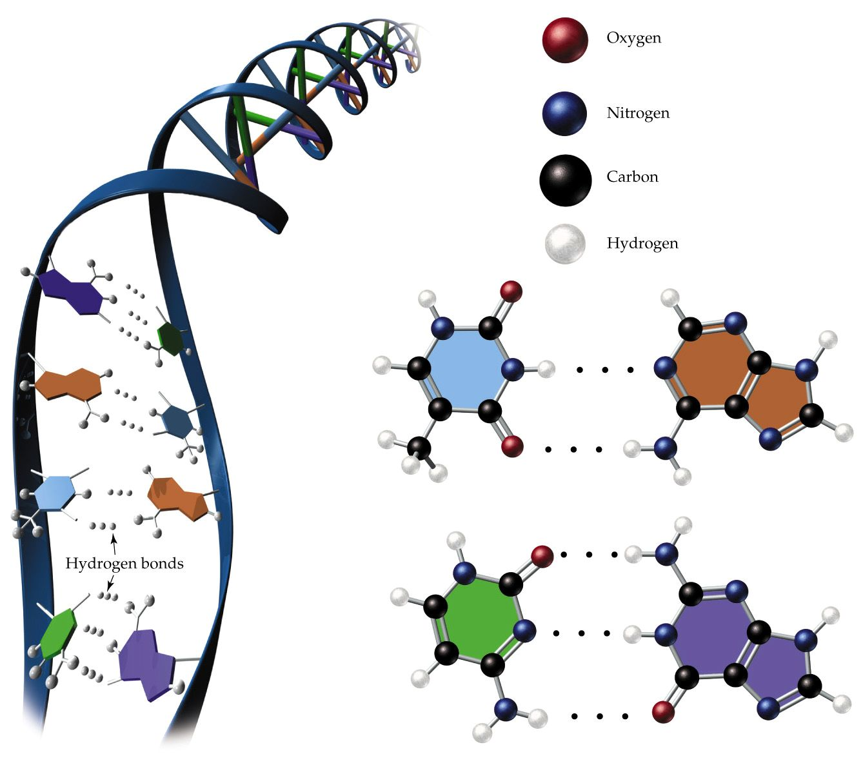

Slide 14
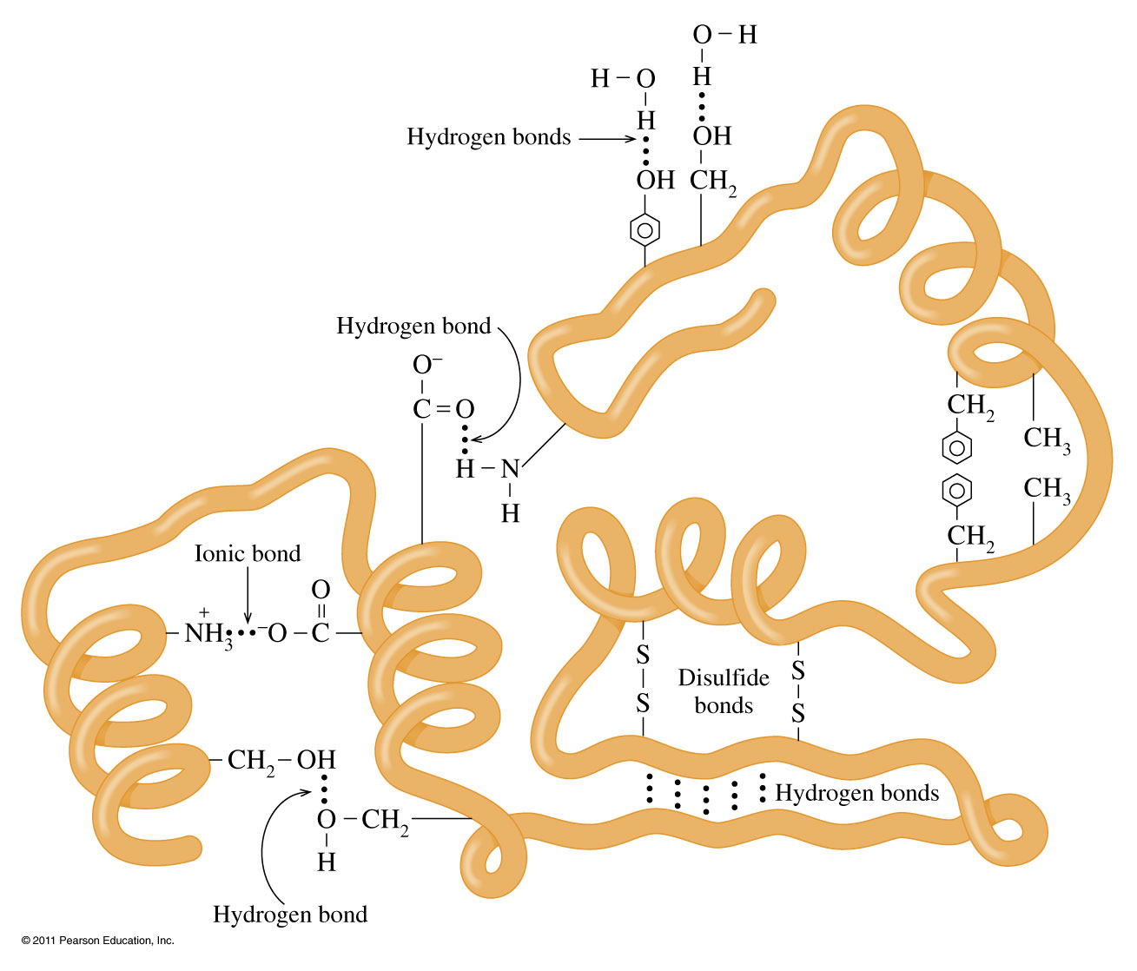

Slide 15
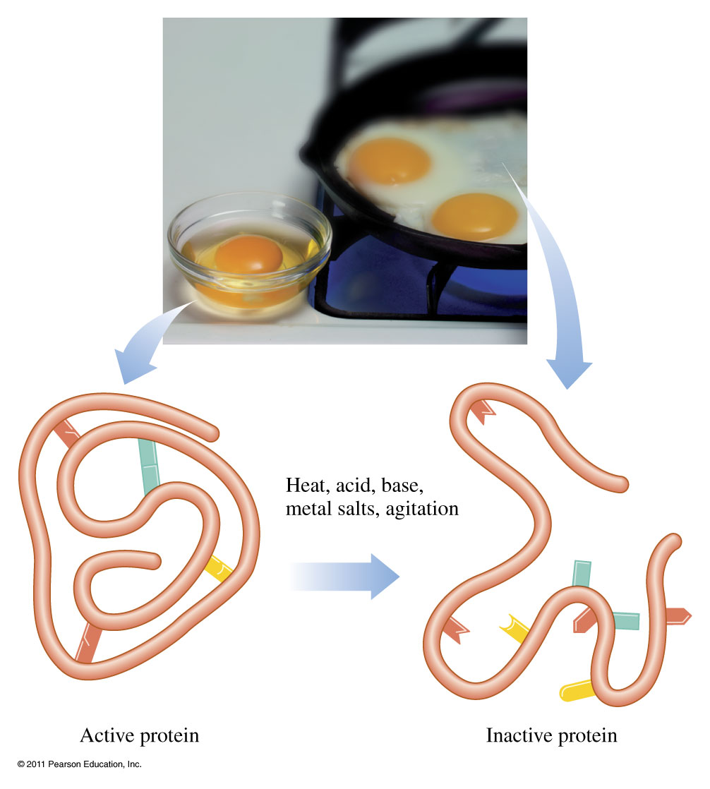

Slide 16
How do intermolecular forces affect molecular properties?

Slide 17
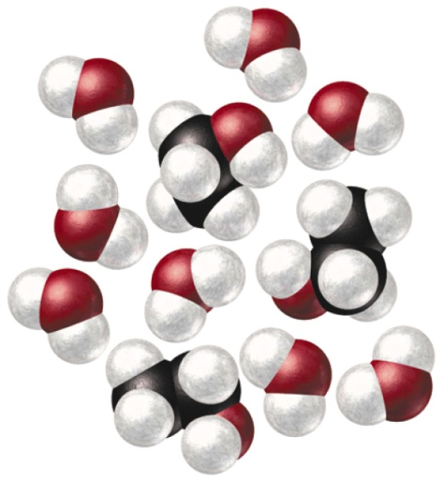
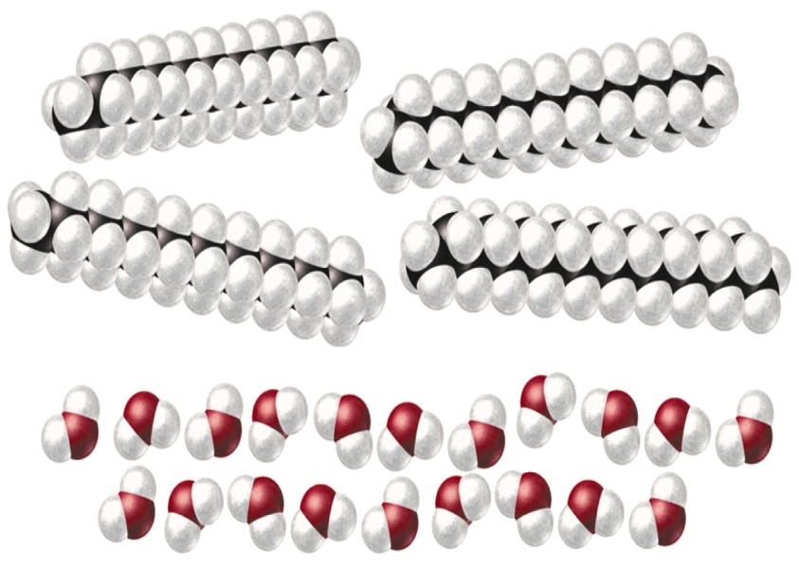
Solubility
Like dissolves Like

Slide 18
Viscosity
resistance to flow
If a liquid has strong intermolecular interactions then particles will not flow past each other easily and viscosity will be high.

Slide 19
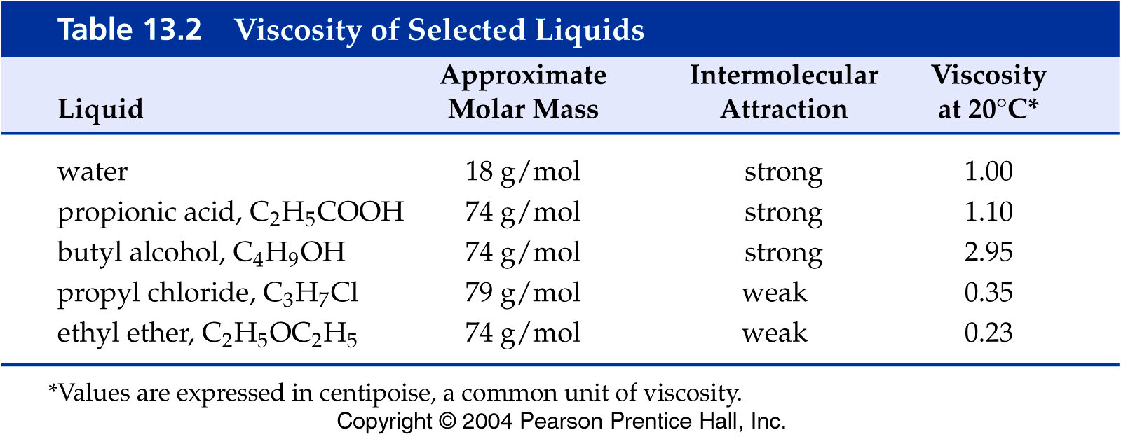

Slide 20
Surface Tension
tendency to minimize surface area
Adhesion – Forces that bind a substance to a surface
Cohesion – Forces that bind a substance to itself

Slide 21
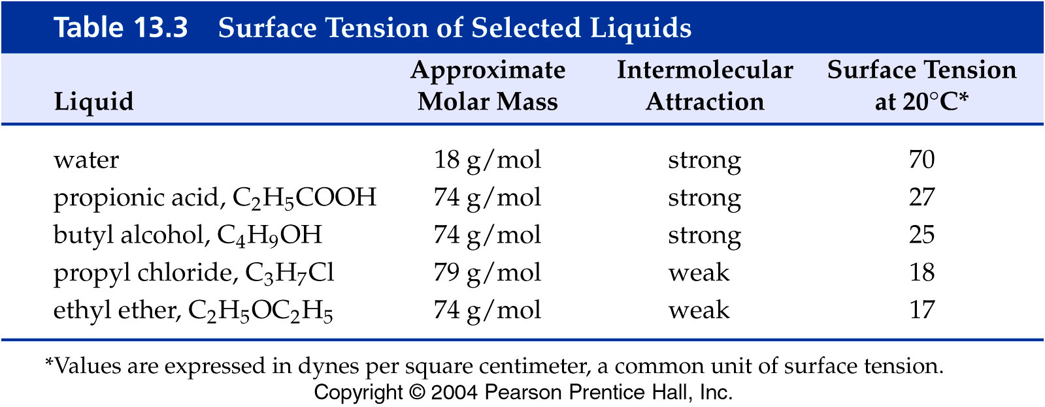

Slide 22
Vapor Pressure
The pressure exerted by a vapor in equilibrium with its liquid phase.

Slide 23
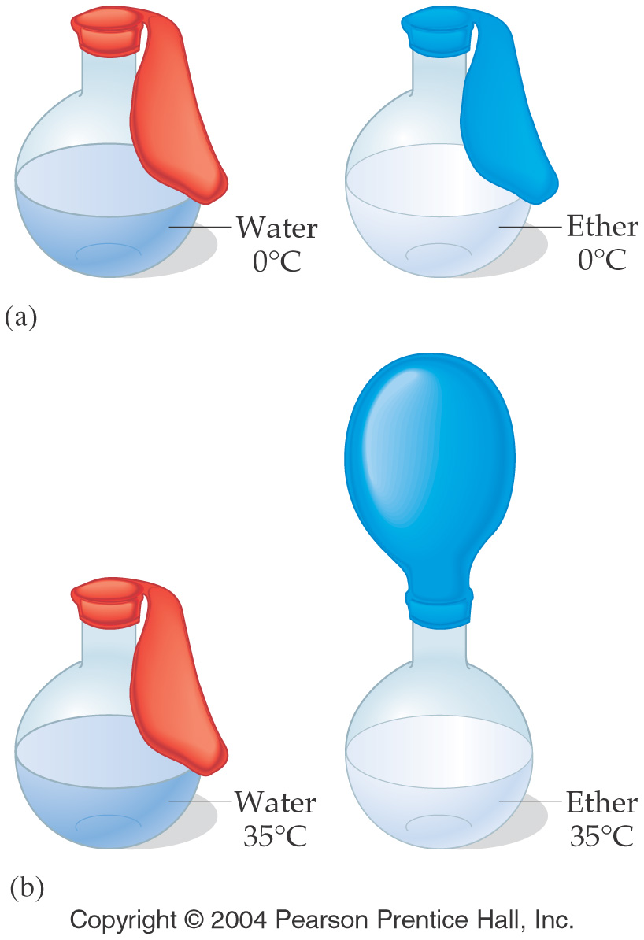

Slide 24
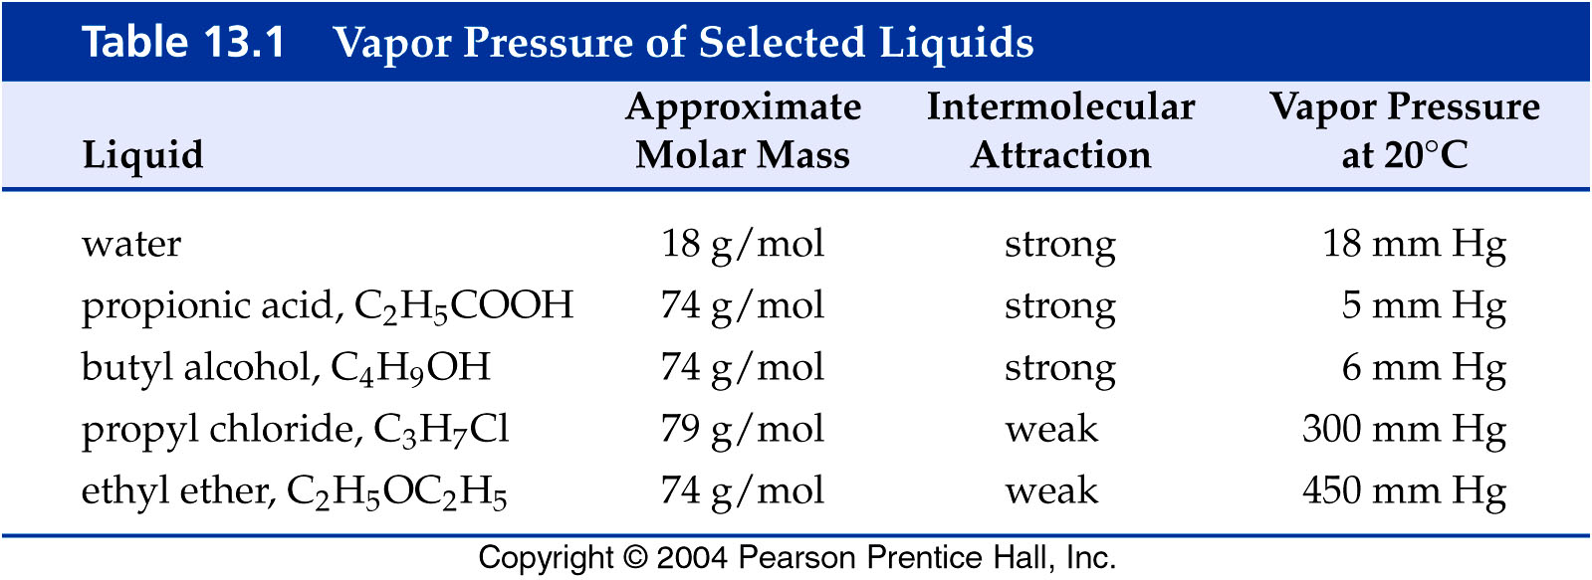

Slide 25
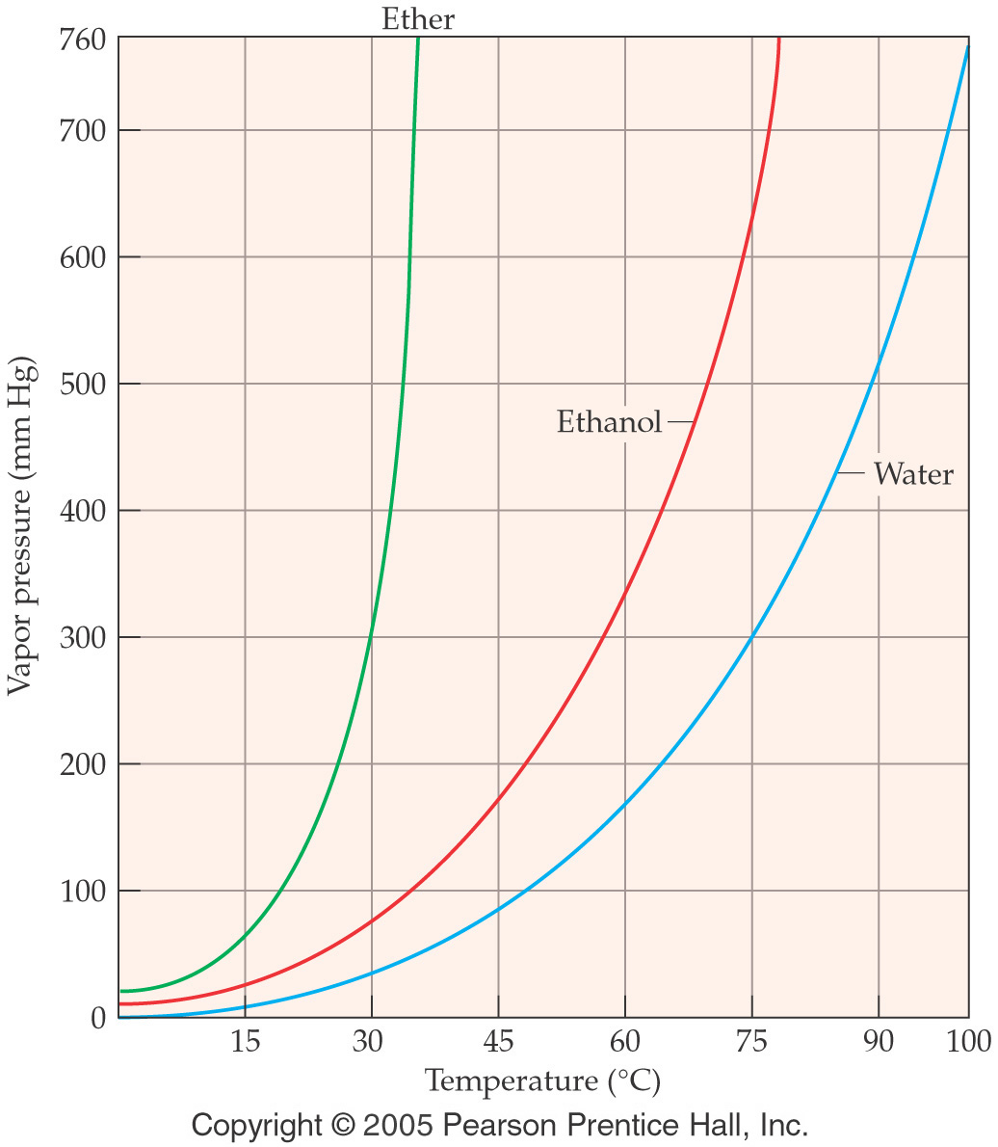

Slide 26
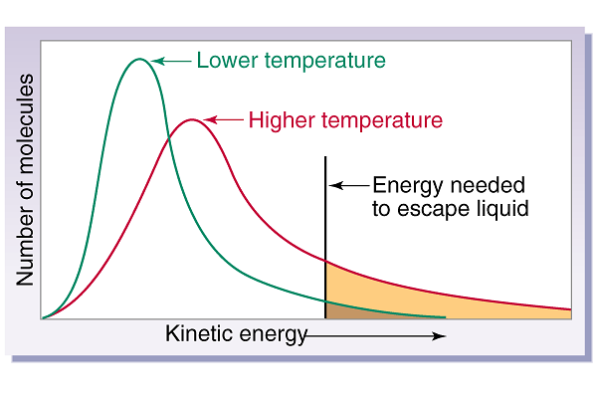

Slide 27
Boiling point
the temperature at which the vapor pressure of a liquid is equal to the atmospheric pressure.

Slide 28
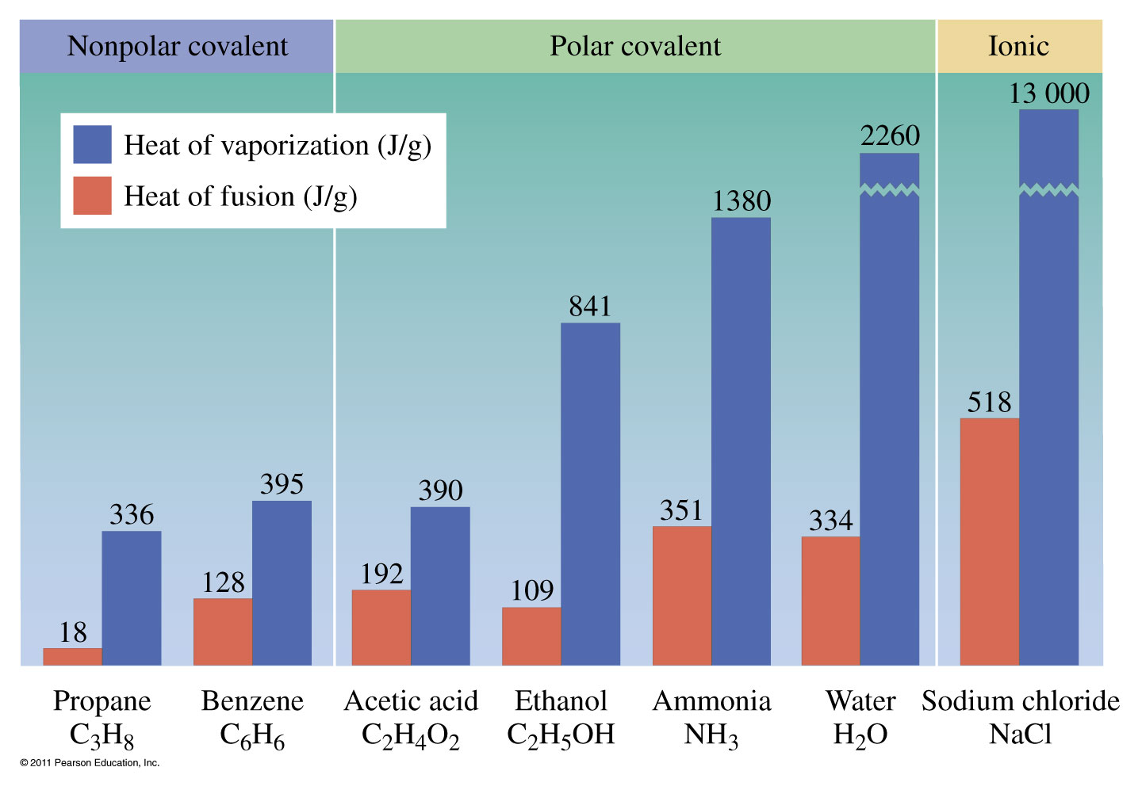

Slide 29
Crystalline solid – atoms, ions, or molecules lie in an orderly array
typically have flat well defined surfaces called faces.
Amorphous solid – atoms or molecules lie in random jumble.

Slide 30
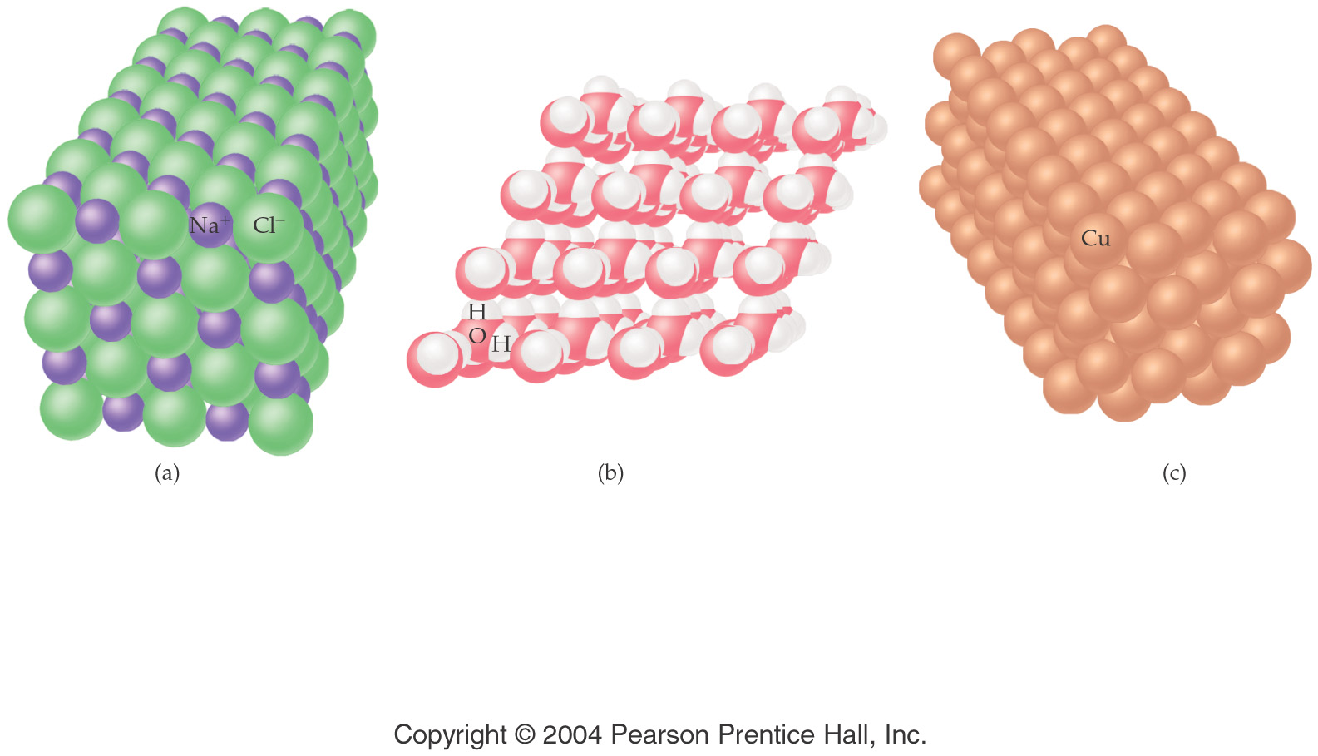

Slide 31
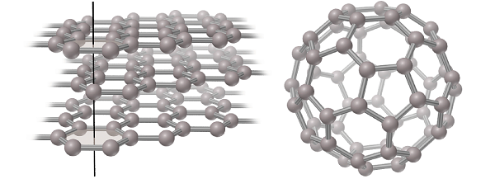
Carbon allotropes

Slide 33
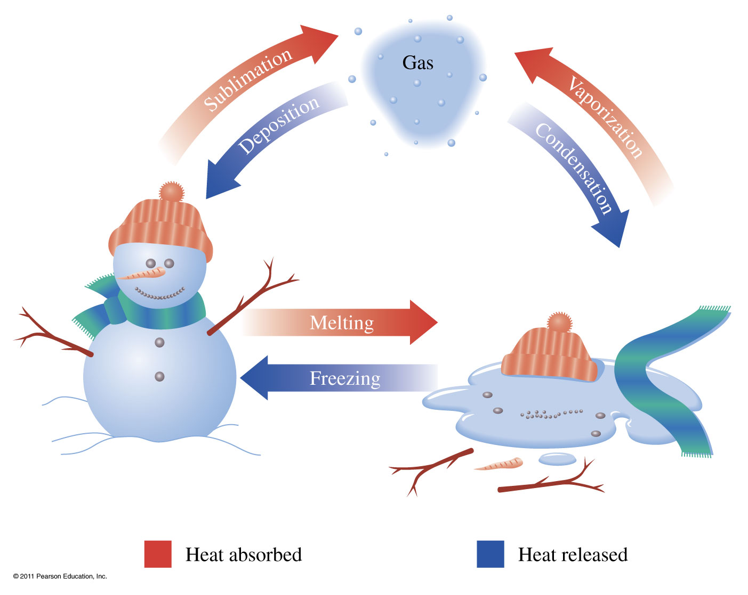
Phase Transitions
Vaporization Liquid to gas transition Condensation Gas to liquid transition
Melting Solid to liquid transition Freezing liquid to solid transition
Sublimation Solid to gas transition Deposition Gas to solid transition

Slide 34
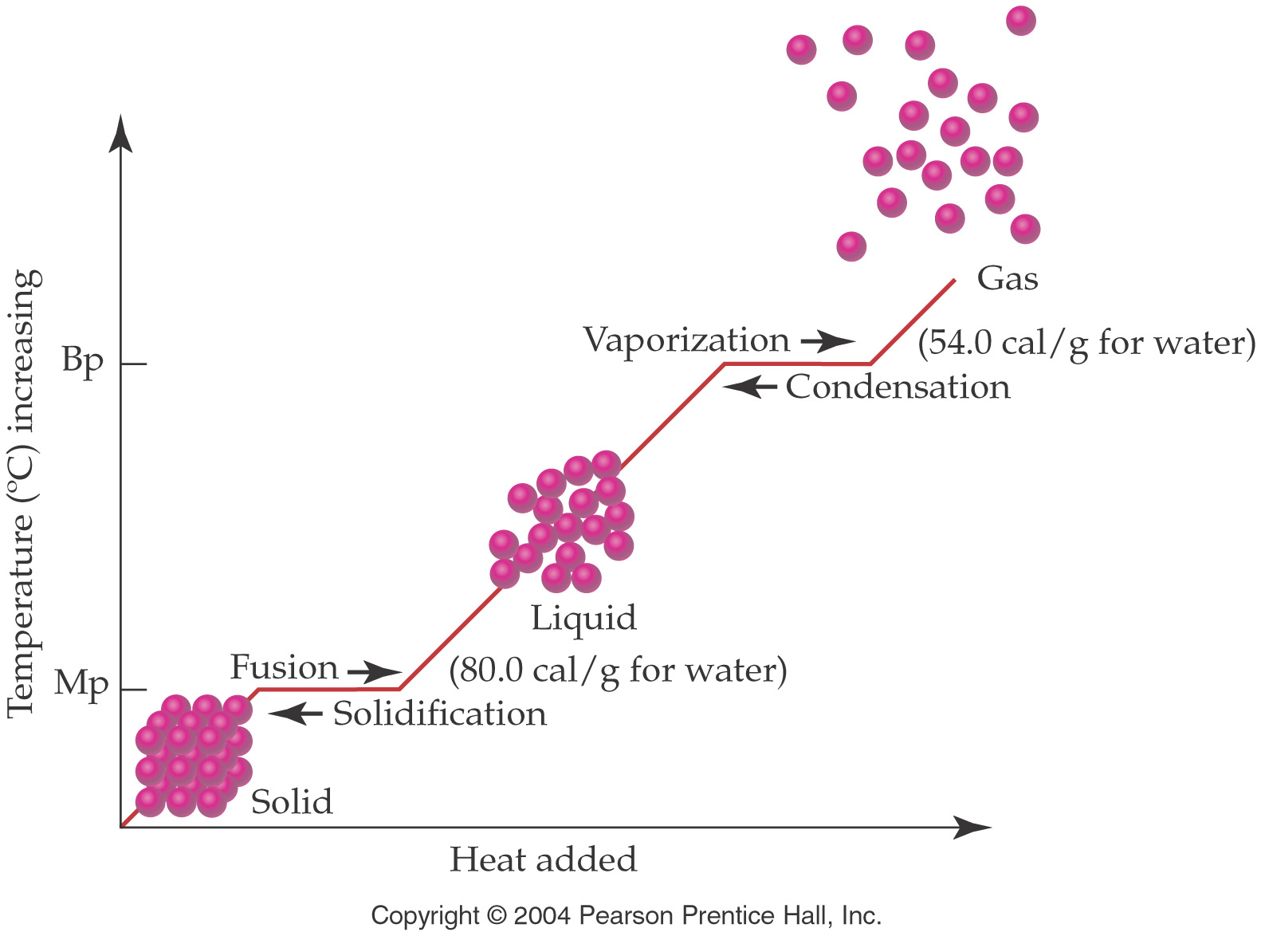

Slide 35
Water
colorless, odorless, tasteless, liquid at ordinary temperatures
only inorganic compound occurring naturally as a liquid
composes ~65% of mass of living organisms
excellent solvent for many things
abnormally high boiling and melting point
ice is less dense than water (it floats)

Slide 36
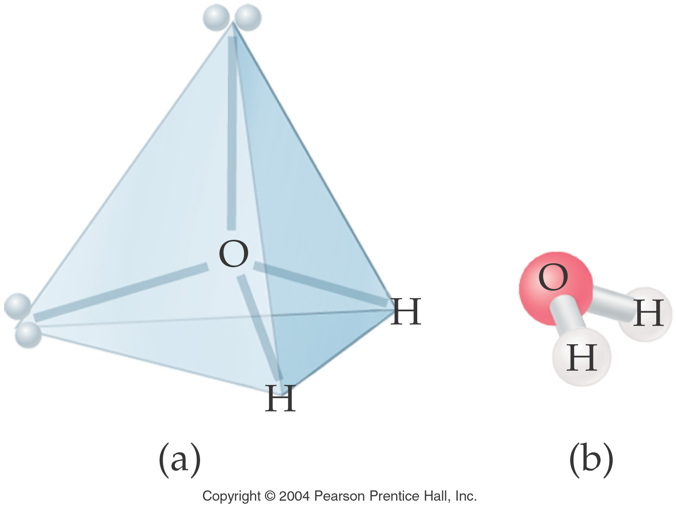

Slide 37
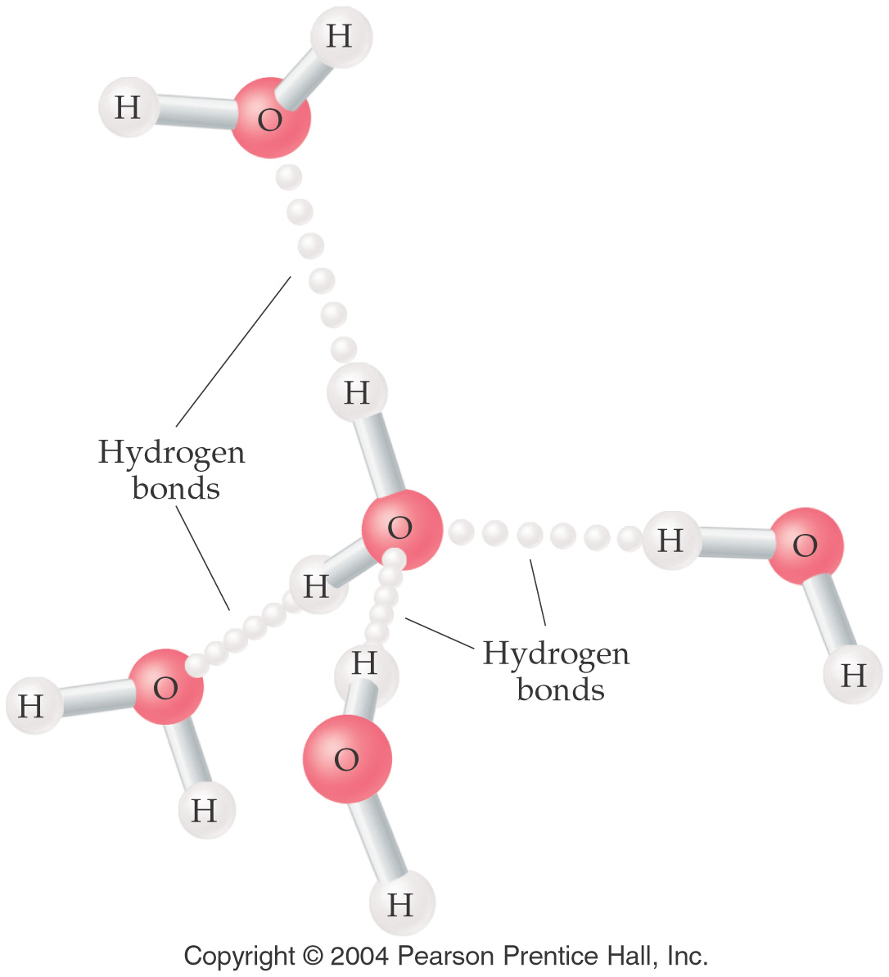

Slide 38
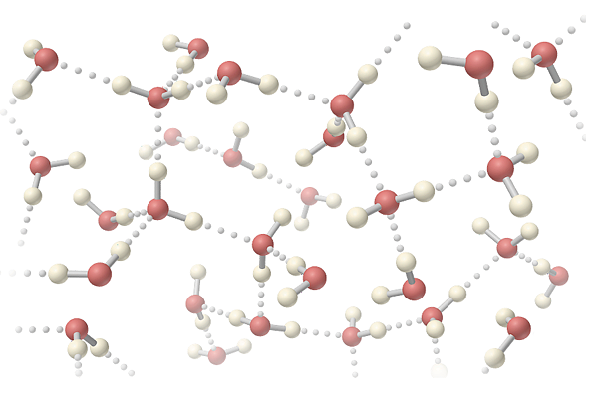

Slide 39
Liquid and solid water

Slide 41
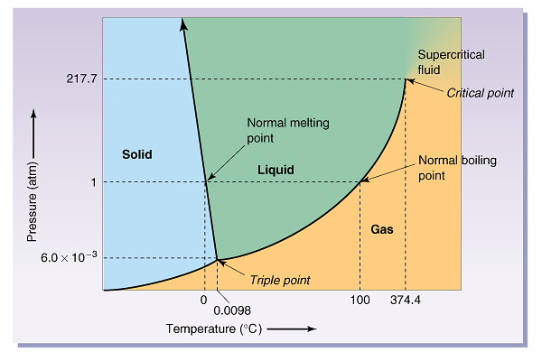
Phase diagram for H₂O

Slide 42
Water purification
Hard water -- Contains Ca⁺², Mg⁺², Fe⁺³ and other minerals.
Soft water -- Doesn’t contain Ca⁺², Mg⁺², Fe⁺³ ions.
Softened water -- metal cations in hard water are replaced by Na⁺.
Deionized water -- cations are replaced by H⁺ and anions are replaced by OH⁻

Slide 43
